Slide 1


Slide 2


VENN DIAGRAMS

Slide 3
VENN DIAGRAMS:
Venn diagrams are an efficient way of representing and
analyzing sets and performing set operations.
Sets are generally represented by circles.
The universal set is represented by a rectangle that encloses all other sets.
∪ is Union: is in either set or both sets
∩ is Intersection: only in both sets
− is Difference: in one set but not the other

Slide 4
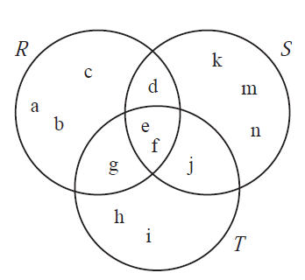
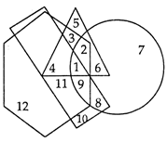
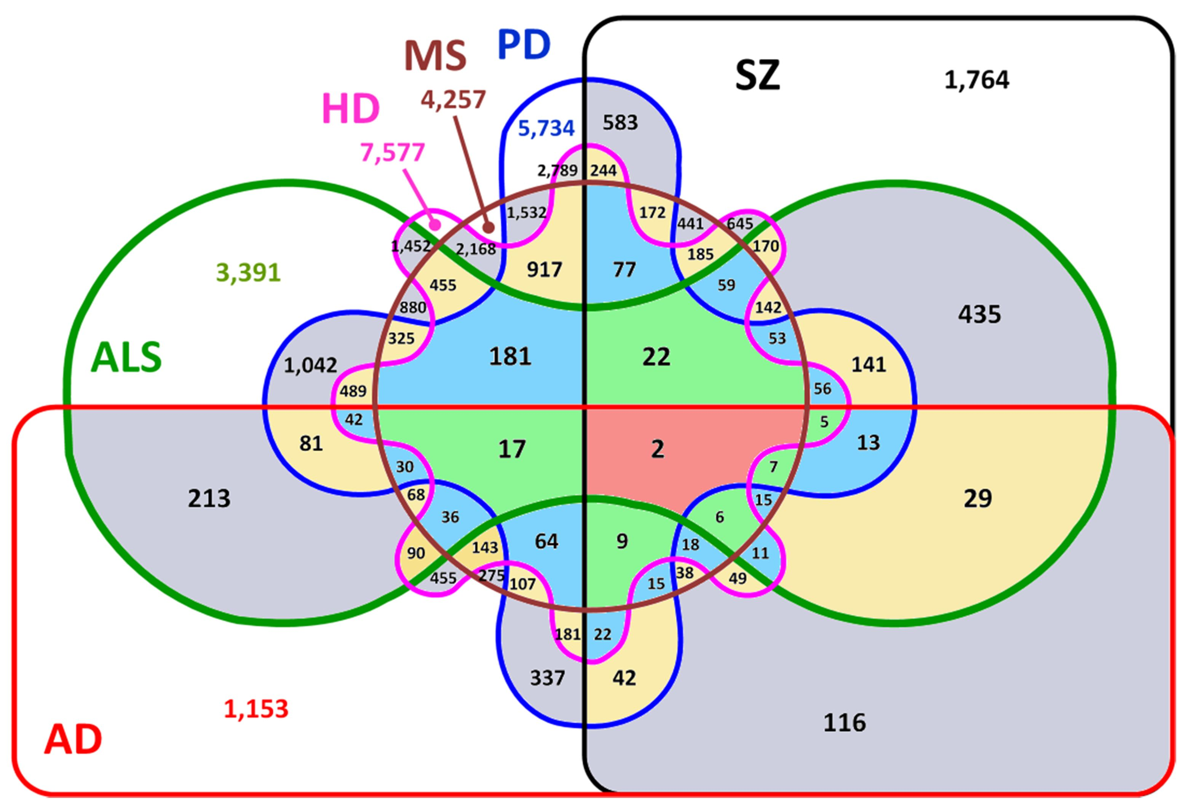
VENN DIAGRAMS:

Slide 5
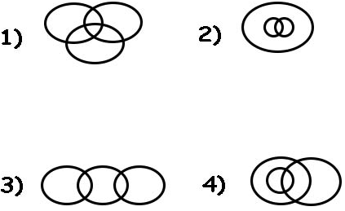
Question: 01
Which of the following Venn- diagram correctly illustrates the
relationship among the classes : Tennis fans, Cricket players, Students
1
2
3
4
Answer: A

Slide 6
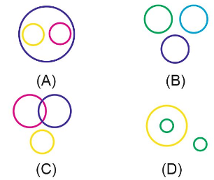
Question: 02
Which of the following diagram shows the relation between
Sun, Moon, & Stars?
Answer: D

Slide 7
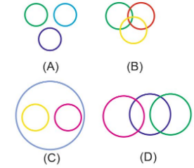
Question: 03
The following elements can be fitted in one of the following diagrams. Select the appropriate option.
Lotus, Flower, Rose
Answer: C

Slide 8
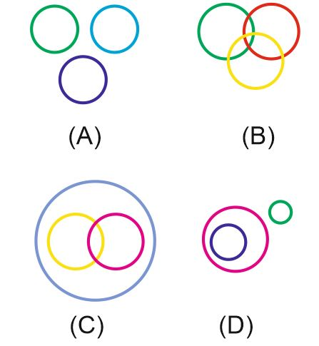
Question: 04
The following elements can be fitted in one of the following
diagrams. Select the appropriate option.
Triangle, Quadrilateral, Square
Answer: D

Slide 9
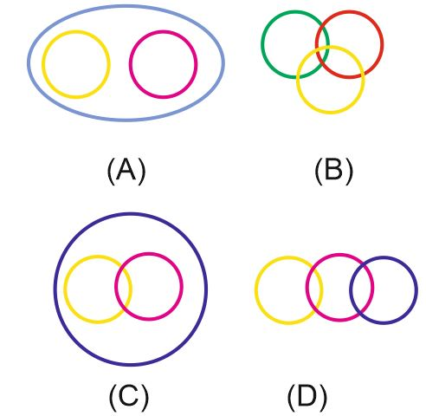
Question: 05
The following elements can be fitted in one of the following diagrams. Select the appropriate option.
Dog, Cat, Animal
Answer: A

Slide 10
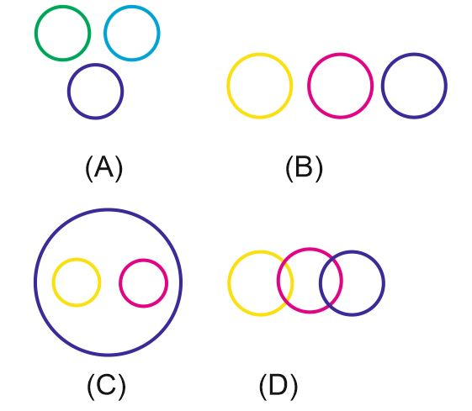
Question: 06
The following elements can be fitted in one of the following diagrams. Select the appropriate option.
Gold, Metal, Zinc
Answer: C

Slide 11
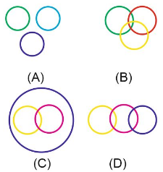
Question: 07
The following elements can be fitted in one of the following diagrams. Select the appropriate option.
Iron, Copper, Brass
Answer: A

Slide 12
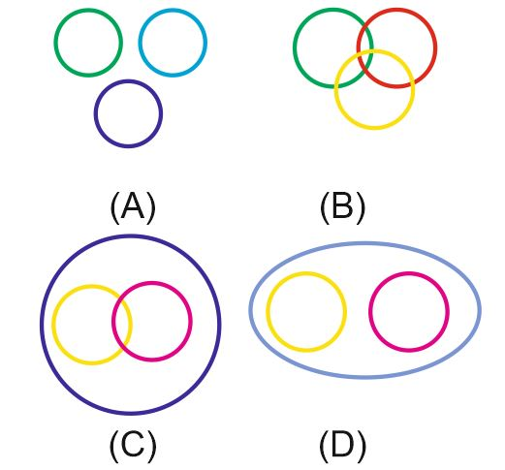
Question: 08
The following elements can be fitted in one of the following diagrams. Select the appropriate option.
Pant, Shirt, Cloth
Answer: D

Slide 13
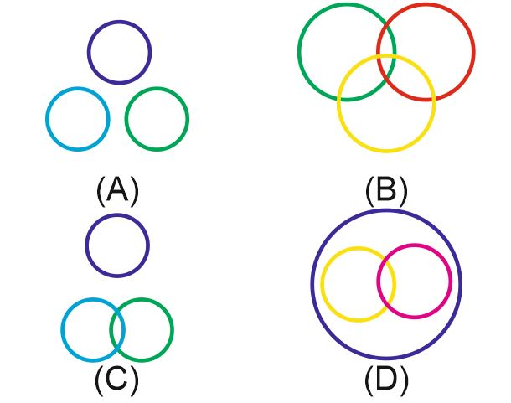
Question: 09
Select the figure which shows the relation between Athletes, Footballers & Cricketers.
Answer: B

Slide 14
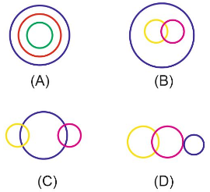
Question: 10
Which figure represents Carrot, Food & Vegetable?
Answer: A

Slide 15
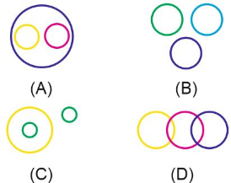
Question: 11
The following elements can be fitted in one of the following
diagrams. Select the appropriate option.
Nitrogen, Hydrogen, Water
Answer: C

Slide 16
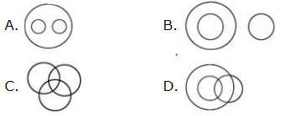
Question: 12
Which of the following diagrams indicates the best relation between Steel, Wood, and Building Material?
Answer: A

Slide 17
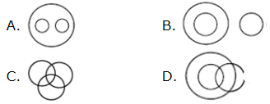
Question: 13
Which of the following diagrams indicates the best relation between Humans, Doctors, and Patients?
Answer: C

Slide 18
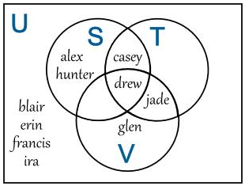
Question: 14
From the above Venn diagram, what is the set
U - T?
{casey, drew, jade}
{alex, blair, erin, francis, glen, hunter, ira}
{alex, blair, erin, francis, hunter, ira}
{blair, erin, francis, ira}
Answer: B

Slide 19
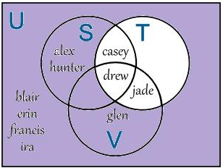
Explanation :
U - T is the set of elements that are in U but not in T
= {alex, blair, erin, francis, glen, hunter, ira}

Slide 20
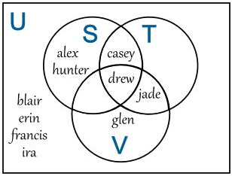
Question: 15
From the above Venn diagram, what is
the set (S ∩ T) ∪ V?
{casey, drew, jade, glen}
{alex, glen, hunter, jade}
{casey, drew, glen}
{drew, jade}
Answer: A

